Slide 1
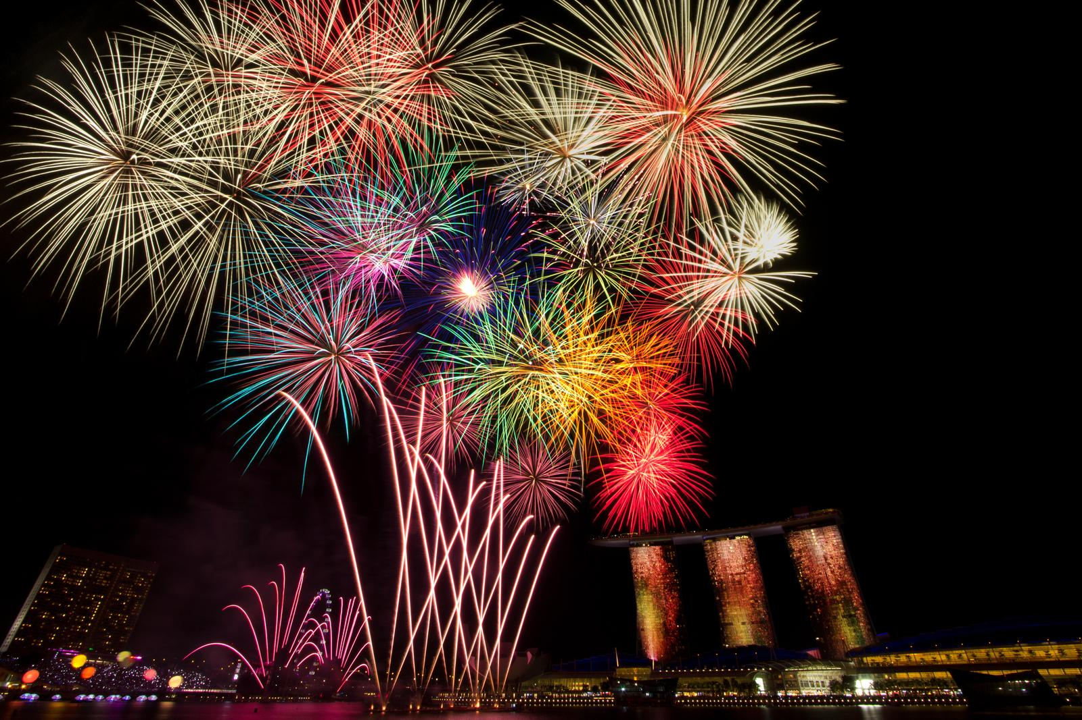
YeAR 6 QUIz

Slide 2
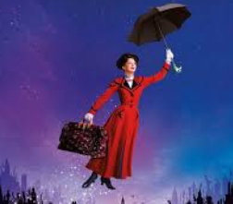
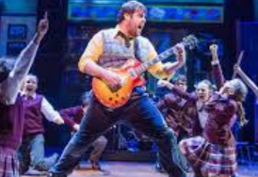
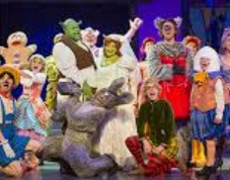
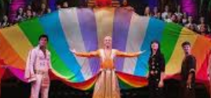
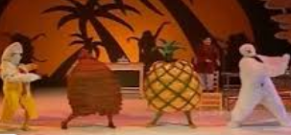
Name tHE west end SHOW
1
2
3
4
5
6
7
8
9
10
11
12

Slide 3
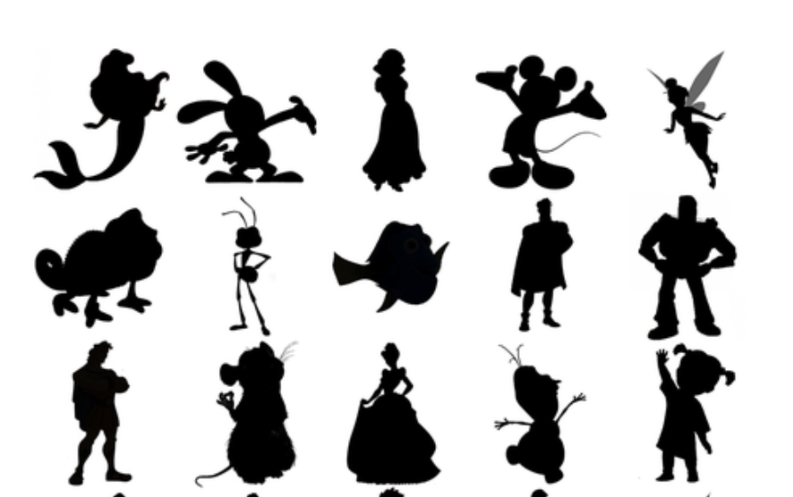

Slide 4
1
5
8
1
6
2
9
3
7
4

Slide 5
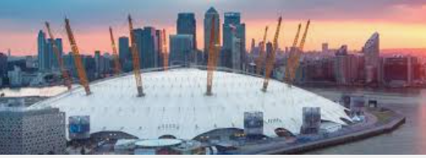
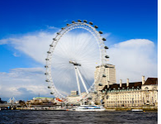
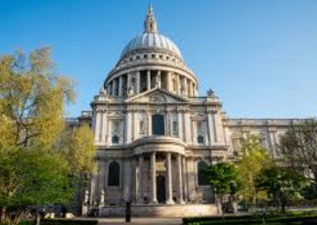
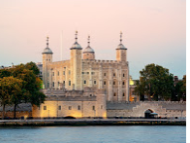
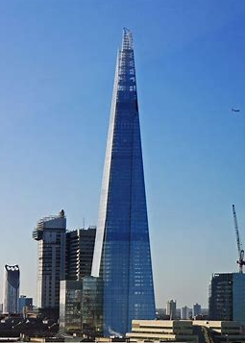
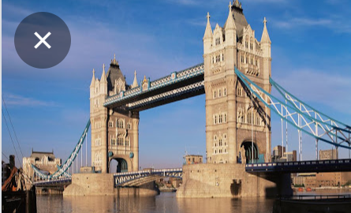
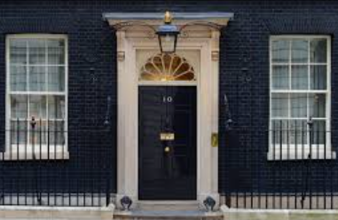
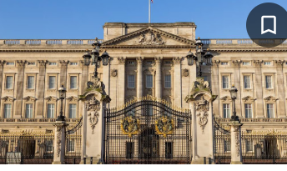
Name the famous London Landmark
4
1
7
2
5
8
3
9
6

Slide 6
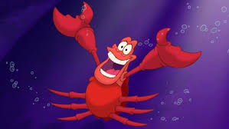
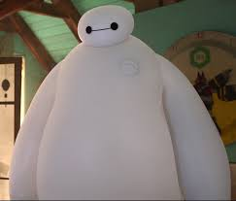
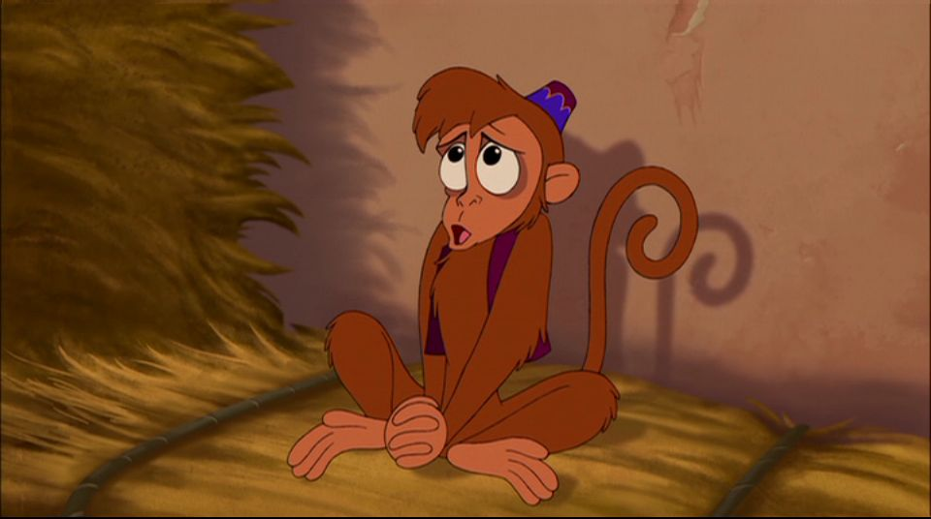
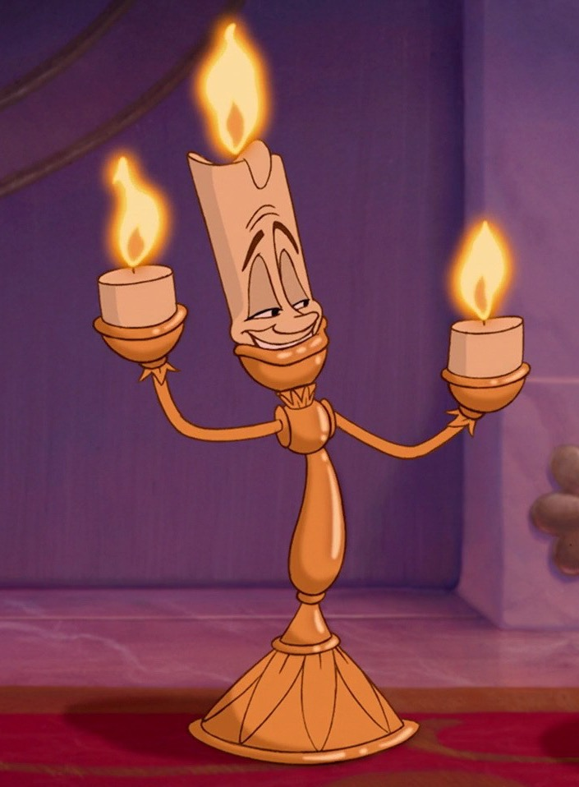
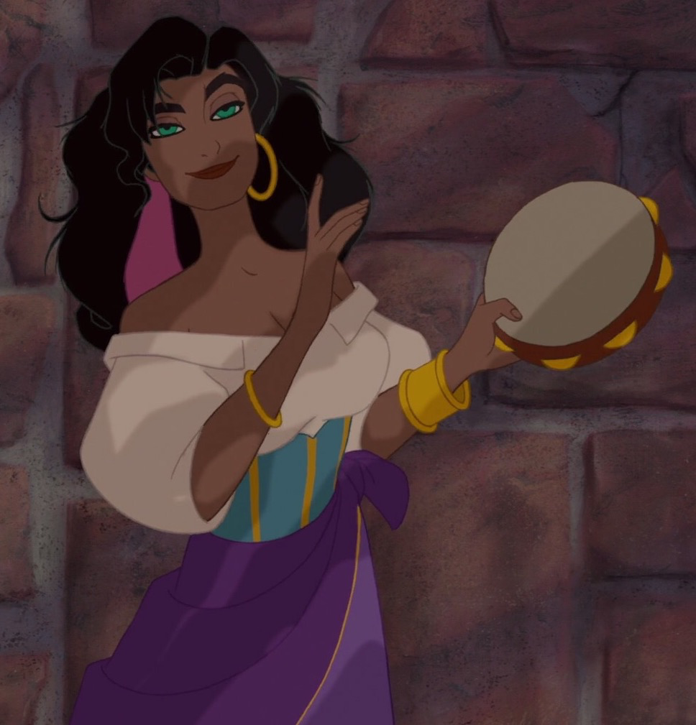
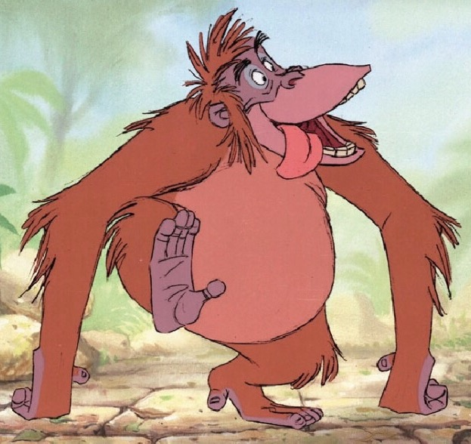
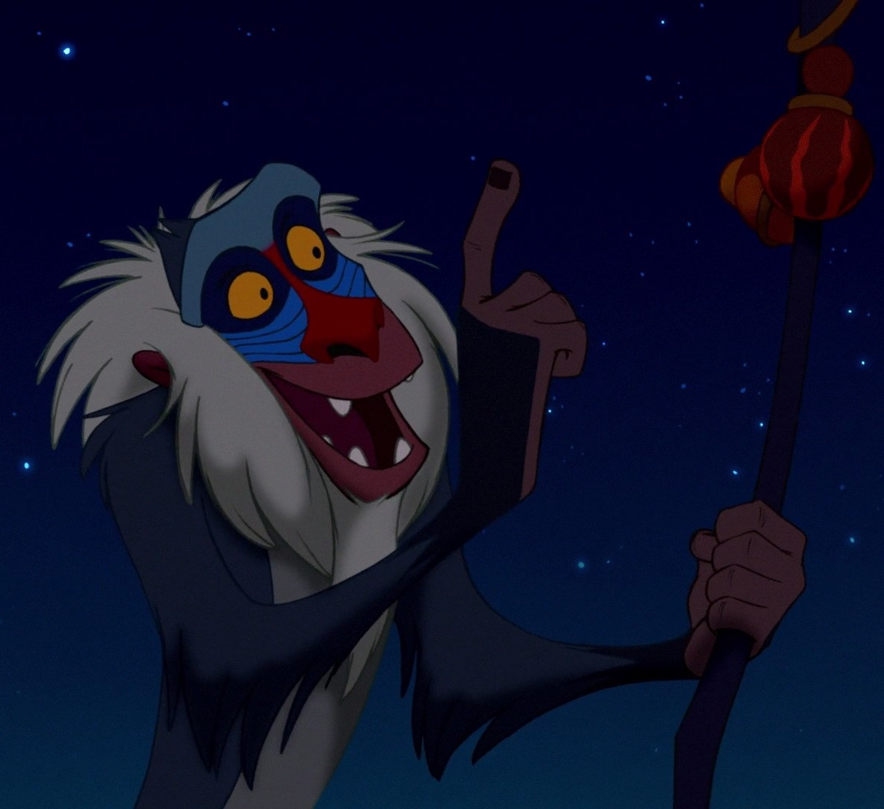
Disney side kicks (name the film and character ½ point for correct film and ½ point for character)
4
1
2
3
6
7
8
5

Slide 7
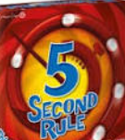
Ava - Name 3 things that go with chips
Erin - Name 3 planets
Charlotte - Name 3 princesses
Phoebe - Name 3 famous Michaels
Francesca - Name 3 things you put on a snowman
Ava - Name 3 places beginning with p
Erin - Name 3 pizza ingredients
Charlotte - Name 3 things you have to peel before eating
Phoebe -Name 3 human organs
Francesca - Names 3 flavours of milkshake

Slide 8
Name thE DISNEY MOVIE from the SONG
https://www.youtube.com/watch?v=2v7QQbJO6aw
https://www.youtube.com/watch?v=TVcLIfSC4OE&t=85s
https://www.youtube.com/watch?v=79DijItQXMM
https://www.youtube.com/watch?v=3pVyXQLy4iA
https://www.youtube.com/watch?v=Ly_vxI4nllA
https://www.youtube.com/watch?v=1at7kKzBYxI

Slide 11
Name that west end musical
1
2
3
4
5
6
7
8
9
10
11
12

Slide 12
Ariel Oswald Snow white Mickey mouse Tinker bell
Pascal Flit Dory Prince Naveen Buzz light year
Hercules Remy Cinderella Olaf Boo

Slide 13
1
5
1
2
6
3
8
7
4
9

Slide 14
Name the famous London Landmark
1
4
London Eye
7
O2
Big Ben
2
5
8
The Shard
St Pauls
Tower of London
3
6
9
Buckingham Palace
Tower Bridge
10 Downing Street

Slide 15
Disney side kicks – name the film and character ½ point for correct film and ½ point for character
4
1
2
3
Robin Hood – Little John
Little Mermaid – Sebastian
Big Hero 6 – Baymax
Alladin – Abu
Jungle Book – King Louie
Beauty and the Beast - Lumiere
Hunchback of Notre Dame – Esmerelda
Lion King - Rafiki
6
7
8
5

Slide 16
Name thE DISNEY MOVIE from the SONG
https://www.youtube.com/watch?v=2v7QQbJO6aw
Princess and the Frog
https://www.youtube.com/watch?v=TVcLIfSC4OE&t=85s
Mulan
https://www.youtube.com/watch?v=79DijItQXMM
Moana
https://www.youtube.com/watch?v=3pVyXQLy4iA
Pocahontas
https://www.youtube.com/watch?v=Ly_vxI4nllA
Lady and the tramp
https://www.youtube.com/watch?v=1at7kKzBYxI
Aladdin

