Slide 2
Word Scramble Puzzle
Day 1
Spelling Focus – S17: Words with the /r/ sound spelt ‘wr’
Unscramble these words that all contain a /r/ sound made with a ‘wr’.
The numbered squares will also make a /r/ sound spelt with ‘wr’ secret code word.
w | r | i | s | t
w | r | o | n | g
w | r | a | p
w | r | e | s | t | l | e
r | i | t | w | s
r | o | g | n | w
r | p | w | a
w | e | r | e | l | s | t
 | 2 | 3
1
 |  |  |  | 4 |  | 5
 | 1 | 2 | 3 | 4 | 5

Slide 3
Day 1
Spelling Focus – S17: Words with the /r/ sound spelt ‘wr’
Word Scramble Puzzle - Answers
Unscramble these words that all contain a /r/ sound made with a ‘wr’.
The numbered squares will also make a /r/ sound spelt with ‘wr’ secret code word.
w | r | i | s | t
w | r | o | n | g
w | r | a | p
w | r | e | s | t | l | e
r | i | t | w | s
r | o | g | n | w
r | p | w | a
w | e | r | e | l | s | t
 | 2 | 3
1
 |  |  |  | 4 |  | 5
 | 1 | 2 | 3 | 4 | 5
 | w | r | i | t | e
 | 1 | 2 | 3 | 4 | 5
Now, use the secret code word in a command sentence.

Slide 4
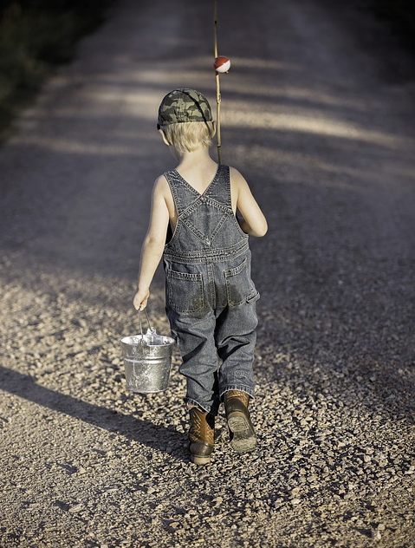
Reading a Picture
Day 2
Reading Focus – 1d: Make inferences from a text or picture
Look at this picture and then talk about these questions with a partner.
Where do you think the boy has been? How do you know?
What do you think the weather is like?
Why might his dungarees be dirty?
How do you think the boy might be feeling? Why?
Try to use the linking words because, when, if, so and but in your answers.

Slide 5
Reading a Picture - Answers
Day 2
Reading Focus – 1d: Make inferences from a text or picture
Where do you think the boy has been? How do you know?
I noticed that the boy had a fishing rod and bucket so he must have been fishing.
What do you think the weather is like?
The weather looks bright and it must be warm because the boy isn’t wearing that many clothes.
Why might his dungarees be dirty?
The boy’s dungarees might be dirty because he has been sitting on the damp ground.
How do you think the boy might be feeling? Why?
The boy might be feeling delighted if he’s had fun and managed to catch a fish, but if he’s not caught anything, he might be feeling upset and frustrated.

Slide 6
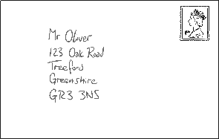
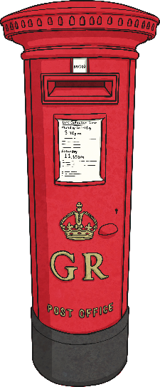
Post Box Sorting
Day 3
Grammar Focus – G2: Functions of Sentences
Can you sort the statement, question, command and exclamation sentences into the correct post box?
As an extra challenge, try to think of a sentence of your own that you could put into each post box.
What an amazing day I’ve had
Would you like to come to my party
Stick the ribbon on with glue
How are you feeling today
Sasha made a birthday cake for her sister
How cute my new kitten is
Statements
Questions
Commands
Exclamations

Slide 7
Day 3
Grammar Focus – G2: Functions of Sentences
Post Box Sorting - Answers
Can you sort the statement, question, command and exclamation sentences into the correct post box?
As an extra challenge, try to think of a sentence of your own that you could put into each post box.
What an amazing day I’ve had
Would you like to come to my party
Stick the ribbon on with glue
How are you feeling today
Sasha made a birthday cake for her sister
How cute my new kitten is
Statements
Questions
Commands
Exclamations

Slide 8
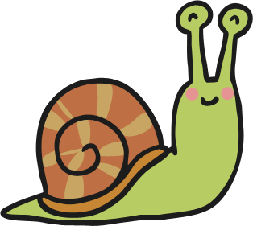
We’re Going on a Word Hunt!
Day 4
Reading Focus – 1a: Draw on knowledge of vocabulary to understand texts
Once upon a time, there were four little snails and their names were Slimy, Slowcoach, Slinky and Bob.
“I’m off to the shops,” said Mrs Snail one morning. “You may go out into the long grass or next to the pond but don’t go into grumpy Mr Green’s garden. Your father once went there and it ended in a CRUNCH!”
Slimy, Slowcoach and Slinky, who were all obedient little snails, went into the long grass for a quick munch but Bob, who was always mischievous, crawled straight away to Mr Green’s vegetable patch. First, he chomped on some scrumptious cabbage. Next, he chewed on some delicious carrot tops and then he crunched through a yummy lettuce. Feeling rather sick, he decided to head back home but just around the corner of the greenhouse, whom should he meet but Mr Green himself!
“Stop, you slippery little thief!” he yelled at the top of his voice, as he angrily shook his spade high in the air.
Why is the word ‘CRUNCH’ written in capital letters?
What adjectives does the author use to show that Bob is enjoying the vegetables in Mr Green’s garden?
What sort of man is Mr Green? Which words and phrases give you clues about him?

Slide 9
We’re Going on a Word Hunt! - Answers
Day 4
Reading Focus – 1a: Draw on knowledge of vocabulary to understand texts
Once upon a time, there were four little snails and their names were Slimy, Slowcoach, Slinky and Bob.
“I’m off to the shops,” said Mrs Snail one morning. “You may go out into the long grass or next to the pond but don’t go into grumpy Mr Green’s garden. Your father once went there and it ended in a CRUNCH!”
Slimy, Slowcoach and Slinky, who were all obedient little snails, went into the long grass for a quick munch but Bob, who was always mischievous, crawled straight away to Mr Green’s vegetable patch. First, he chomped on some scrumptious cabbage. Next, he chewed on some delicious carrot tops and then he crunched through a yummy lettuce. Feeling rather sick, he decided to head back home but just around the corner of the greenhouse, whom should he meet but Mr Green himself!
“Stop, you slippery little thief!” he yelled at the top of his voice, as he angrily shook his spade high in the air.
Why is the word ‘CRUNCH’ written in capital letters?
The word ‘CRUNCH’ is written in capital letters to show that it was a loud and surprising noise. I think it was the noise that happened when grumpy Mr Green stood on Mr Snail.

Slide 10
We’re Going on a Word Hunt! - Answers
Day 4
Reading Focus – 1a: Draw on knowledge of vocabulary to understand texts
Once upon a time, there were four little snails and their names were Slimy, Slowcoach, Slinky and Bob.
“I’m off to the shops,” said Mrs Snail one morning. “You may go out into the long grass or next to the pond but don’t go into grumpy Mr Green’s garden. Your father once went there and it ended in a CRUNCH!”
Slimy, Slowcoach and Slinky, who were all obedient little snails, went into the long grass for a quick munch but Bob, who was always mischievous, crawled straight away to Mr Green’s vegetable patch. First, he chomped on some scrumptious cabbage. Next, he chewed on some delicious carrot tops and then he crunched through a yummy lettuce. Feeling rather sick, he decided to head back home but just around the corner of the greenhouse, whom should he meet but Mr Green himself!
“Stop, you slippery little thief!” he yelled at the top of his voice, as he angrily shook his spade high in the air.
What adjectives does the author use to show that Bob is enjoying the vegetables in Mr Green’s garden?
The author uses the adjectives ‘scrumptious’, ‘delicious’ and ‘yummy’ to describe the vegetables from Bob’s point of view.

Slide 11
We’re Going on a Word Hunt! - Answers
Day 4
Reading Focus – 1a: Draw on knowledge of vocabulary to understand texts
Once upon a time, there were four little snails and their names were Slimy, Slowcoach, Slinky and Bob.
“I’m off to the shops,” said Mrs Snail one morning. “You may go out into the long grass or next to the pond but don’t go into grumpy Mr Green’s garden. Your father once went there and it ended in a CRUNCH!”
Slimy, Slowcoach and Slinky, who were all obedient little snails, went into the long grass for a quick munch but Bob, who was always mischievous, crawled straight away to Mr Green’s vegetable patch. First, he chomped on some scrumptious cabbage. Next, he chewed on some delicious carrot tops and then he crunched through a yummy lettuce. Feeling rather sick, he decided to head back home but just around the corner of the greenhouse, whom should he meet but Mr Green himself!
“Stop, you slippery little thief!” he yelled at the top of his voice, as he angrily shook his spade high in the air.
What sort of man is Mr Green? Which words and phrases give you clues about him?
I think Mr Green is a bad-tempered and angry gardener. The story describes him as ‘grumpy’ and he yells at the top of his voice and shakes his spade angrily at Bob. I also think that he may have stepped on Bob’s dad.

Slide 12
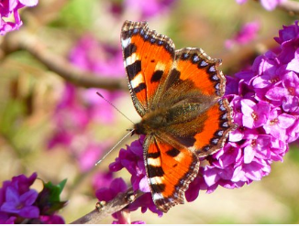
Think & Write
Day 5
Punctuation, Grammar and Vocabulary Focus – Mixed Skills
Look at this picture. What words and sentences does it make you think of? We are going to write a short piece of text based on the picture, using the following pattern of sentences:
Sentence 1
Write a sentence with an expanded noun phrase.
Sentence 2
Write a past progressive sentence.
Sentence 3
Write a sentence that uses an apostrophe about something belonging to the butterfly.
Sentence 4
Write a ‘Did you know?’ question.
Read through your writing carefully – does it include everything we are looking for?

Slide 13
Day 5
Punctuation, Grammar and Vocabulary Focus – Mixed Skills
Think & Write - Answers
Here’s an example of what you could have thought and written:
The stunning and colourful butterfly floated down onto a flower.
She was using her antennae to sense all around her.
The butterfly’s wings were covered in many beautiful patterns.
Did you know that she used to be a caterpillar?
Share your writing with a partner, your group or your whole class.

